Slide 1
jQuery Controls
Progress bar, star rating & datepicker
By Jaden Ahn

Slide 2
About jQuery UI
What is jQuery UI?
“jQuery UI is a curated set of user interface interactions, effects, widgets, and themes built on top of the jQuery JavaScript Library.”

Slide 3
About jQuery UI
First! Link External script
<html>
<head>
<link rel="stylesheet" href="//code.jquery.com/ui/1.12.1/themes/base/jquery-ui.css">
<link rel="stylesheet" href="/resources/demos/style.css">
<script src="https://code.jquery.com/jquery-1.12.4.js"></script>
<script src="https://code.jquery.com/ui/1.12.1/jquery-ui.js"></script>
</head>
</html>
http://jqueryui.com/download/all/

Slide 4
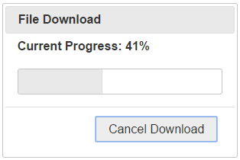
jQuery UI Example 1: Progress Bar
What is Progress Bar?
“Progress bar is a user interface element that indicates the progress of an operation.”

Slide 5
jQuery UI Example 1: Progress Bar
Two simple steps to add jQuery progressbar
Make a div element with an id in the html page
Select the div element using jQuery and call progressbar() function
<div id="progressbar"></div>
$( "#progressbar" ).progressbar();

Slide 6
jQuery UI Example 1: Progress Bar
Sample code: default
<html>
<body>
<h2>Progress Bar: default</h2>
<div id="progressbar"></div>
<script>
//code to include progress bar
$( document ).ready( function() {
$( "#progressbar" ).progressbar();
});
</script>
</body>
<html>
Sample html

Slide 7
jQuery UI Example 1: Progress Bar
Two Types of Progress bar:
Indeterminate: Use indeterminate progress bar when you do not know how long the progress will take
Determinate: Use determinate progress bar when you want to show that a specific quantity of progress has occurred.

Slide 8
Types of Progress Bar
Indeterminate: To get indeterminate progress bar, set the value option of the progressbar() function to false(boolean)
Determinate: To get determinate progress bar, set the value option of the progressbar() function to an integer value

Slide 9
jQuery UI Example 1: Progress Bar
Sample code: indeterminate
<html>
<body>
<h2>Progress Bar: default</h2>
<div id="progressbar"></div>
<script>
//code to include progress bar
$( document ).ready( function() {
$( "#progressbar" ).progressbar({
value:false
});
});
</script>
</body>
<html>
Sample html

Slide 10
jQuery UI Example 1: Progress Bar
Sample code: determinate
<html>
<body>
<h2>Progress Bar: default</h2>
<div id="progressbar"></div>
<script>
//code to include progress bar
$( document ).ready( function() {
$( "#progressbar" ).progressbar({
value:65
});
});
</script>
</body>
<html>
Sample html

Slide 11
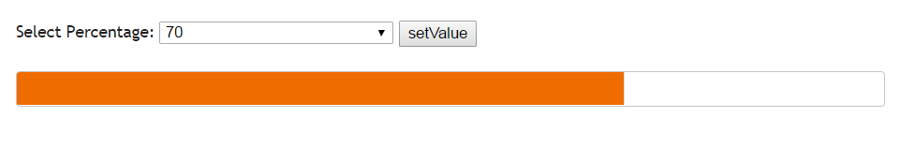
Determinate Progress Bar

Slide 12
jQuery UI Example 1: Progress Bar
Sample code: determinate with variable
<body>
<h2>Progress Bar: determinate</h2>
<select id="percentage">
<option value="0">0</option>
<option value="10">10</option>
…
<option value=“90">90</option>
<option value="100">100</option>
</select>
<input type="button" id="barButton" value="setValue"><br><br>
<div id="progressbar"></div>
Sample html

Slide 13
jQuery UI Example 1: Progress Bar
Sample code: determinate with variable
<script>
$( document ).ready( function() {
$("#progressbar").progressbar();
$("#barButton" ).click(function(){
$("#progressbar").progressbar({
value:parseInt($("#percentage").val())
})
});
});
</script>
</body>
Sample html

Slide 14
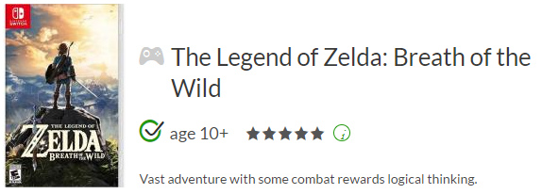
jQuery UI Example 2: Star Rating
What is Star Rating?
“A Star Rating is a way for users to rank a given item using symbols. This data can later be stored and used.
Implemented via a plugin or by creating your own code.”

Slide 15


jQuery UI Example 2: Star Rating
HTML for a Star Rating
- Select the images to be used for your rating and input into your HTML code
<div id="ratingDiv" data-rating="0">
<img class="star" src="..\images\1.png" title="Poor" data-rating="1"/>
<img class="star" src="..\images\1.png" title="Fair" data-rating="2"/>
<img class="star" src="..\images\1.png" title="Good" data-rating="3"/>
<img class="star" src="..\images\1.png" title="Excellent" data-rating="4"/>
<img class="star" src="..\images\1.png" title="Amazing!" data-rating="5"/>
</div>
<button id="reset">Reset</button>
<button id="button">Get Rating</button>

Slide 16


jQuery UI Example 2: Star Rating
1.png
1-1.png
Create Functions To Turn On/Off Images Using Jquery
- Both functions take the current star (this) and change its ‘src’ attribute to a different star image, dependent on the mouse event (click, mouseover or mouseout)
<script>
const STAR_OFF_IMAGE = "../images/1.png";
const STAR_ON_IMAGE = "../images/1-1.png";
$.fn.turnOn = function() {
$(this).attr('src',STAR_ON_IMAGE);
return this;
};
$.fn.turnOff = function() {
$(this).attr('src',STAR_OFF_IMAGE);
return this;
};
</script>

Slide 17
jQuery UI Example 2: Star Rating
Call the turnOn or turnOff functions On Mouse Events
-Use a for loop to ‘turnOn’ the clicked star and the stars ‘below’ it
-Change the data attribute of the div container to that of the clicked star
-“unclicked” variable now set to false – mouseover and mouseout events can no longer occur
<script>
var unclicked = true;
$('.star').click(function ()
{
var currentRating = $(this).data("rating");
for (var i = 1; i <= currentRating; i++) {
$('[data-rating=' + i + ']').turnOn();
$("#ratingDiv").data("rating", i);
}
unclicked = false;
})
</script>

Slide 18
jQuery UI Example 2: Star Rating
Add mouseover and mouseout Events
<script>
.mouseover(function()
{
if(unclicked){
var currentRating = $(this).data("rating");
for (var i = 0; i <= currentRating; i++) {
$('[data-rating='+ i + ']').turnOn();
}
}
})
.mouseout(function()
{
if (unclicked) {
$('.star').turnOff();
}
})
</script>

Slide 19
Using Star Rating Data
Create a function in javaScript to return the data-rating value of the <div> tag
Use a button to show the rating has been changed via an alert
function GetRating()
{
return $("#ratingDiv").data("rating");
}
$("button").click(function(){
alert(GetRating());
});
Sample html

Slide 20
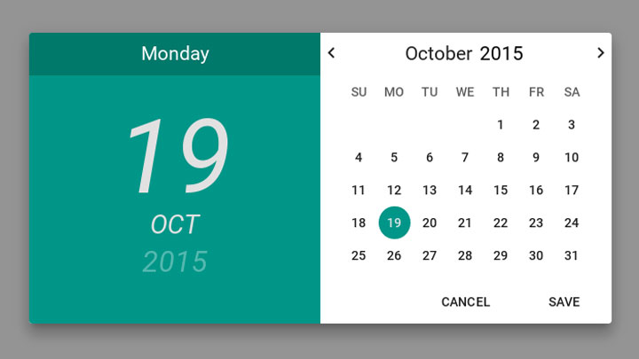
jQuery UI Example 3: Date Picker
What is Date Picker?
“Date picker is a plugin which helps you to input date related data”

Slide 21
jQuery UI Example 3: Date Picker
Two simple steps to add jQuery datepicker
Make an input field with an id on the html page
Select the element with the id using jQuery and call datepicker() function
<p>Date: <input type="text" id="datepicker"></p>
$( "#datepicker" ).datepicker();
Sample html

Slide 22
Datepicker Exercise
1. Add HTML input
<body>
<!--Enter your html code below-->
<p>Date: <input type="text" id="datepicker"></p>
<!--End of html-->
</body>

Slide 23
Datepicker Exercise
2. Add datepicker function
<script>
//Enter your jQuery script below
$( document ).ready( function() {
$( "#datepicker" ).datepicker();
});
//End of jQuery
</script>

Slide 24
Datepicker Exercise
<script>
//Enter your jQuery script below
$( document ).ready( function() {
$( "#datepicker" ).datepicker({
showAnim: 'drop’,
duration: 'fast’,
showOptions: {direction: 'up’},
showOtherMonths: true,
selectOtherMonths: true,
showButtonPanel: true,
changeMonth: true,
changeYear: true,
numberOfMonths: 2
});
});
//End of jQuery
</script>
3. Add options

Slide 25
API documentation
API = “Application Programming Interface”
http://api.jqueryui.com/datepicker/

Slide 26
Any Questions?
Q&A

